Slide 1

The Freemson Build System Version 4.0
July 2007
Rafi Einstein

Slide 2
Title- Limited to 50 Characters/Line Can Also Extend to a Second Line When

Slide 3


Freemason Overview

Slide 4

The Freemason – What is it?
Freemason is a build system.
Its purpose is to build multi-platform software products from source code, in a coherent and a concise way, by a single, simple command, with no user intervention.
Biased towards C/C++ Projects.
Separation of concerns: Build vs. Release.
Notes:
The Build system’s advantages:
A cross-platform tool
Uniform Interface
The process can be fully automated
While being biased towards C/C++ projects, it can be used to compile any source code that has 1-to-1 source-to-object relations, such as Java or C#.
In addition, it can be used to perform operation that span source files and modules.

Slide 5
Freemason Architecture
Framework
Hierarchy of makefiles
Projects
In a moment…
GNU make
With many language extensions
Repository
Compilers
SDKs
Scripts
Site Configuration

Slide 6
Freemason By Example

Slide 7
Simple Project: “Sample1”
Sample1
test1.exe
lib1.lib
Program
Library
test1
lib1
test1.cpp
lib1.cpp
lib.h
Notes:
The first thing we will like to do is to build the code in test1 and lib1 which are called Products in Freemason.
We would like to build the source files in lib1 into a library, and the source files in test1 into an executable file.
Freemason uses the term module to refer to a set of source files (like test1 and lib1) that eventually can be compiled into binary form (that is, a library of some sort or an executable, which we call products).

Slide 8
“Sample1” - Source Code
test1/test1.cpp
lib1/lib1.cpp
#include "lib1/lib1.h"
#include <stdio.h>
int main() {
printf("%s\n", foo());
return 0;
}
const char *foo() {
return "Hello, World!";
}
lib1/lib1.h
const char *foo();

Slide 9
Simple Project: “Sample1”
sample1
test1
lib1
test1.cpp
makefile
lib1.cpp
lib.h
makefile
Notes:
For Freemason to build a module it needs some instructions. Those instructions are written in a language that has no name, but it is known to its acquaintances as the language of a bloke called GNU make.
This file is called, makefile.
The makefiles are placed along with the source files.
The Freemason definitions files (called Framework) are in z:/freemason (most recommended) configuration, Freemason is introduced by including the file main from the Freemason Framework. Once it is done, the variable MK can be used to reference Freemason resources.

Slide 10
Example2 – Simple Project with Makefile
test1/makefile
lib1/makefile
1
2
3
4
5
6
7
8
9
10
11
12
13
14
15
16
17
18
19
20
21
22
23
24
25
26
27
SRC_ROOT=../..
include z:/freemason/4/main
MODULE_NAME=test1
PRODUCT=prog
#-----------------------------
include $(MK)/defs
#-----------------------------
define CC_PP_DEFS.common
endef
define CC_INCLUDE_DIRS.common
..
endef
define CC_SRC_FILES.common
test1.cpp
endef
#-----------------------------
include $(MK)/rules
1
2
3
4
5
6
7
8
9
10
11
12
13
14
15
16
17
18
19
20
21
22
23
24
25
26
SRC_ROOT=../..
include z:/freemason/4/main
MODULE_NAME=lib1
PRODUCT=lib
#----------------------------
include $(MK)/defs
#----------------------------
define CC_PP_DEFS.common
endef
define CC_INCLUDE_DIRS.common
endef
define CC_SRC_FILES.common
lib1.cpp
endef
#----------------------------
include $(MK)/rules
Notes:
test1 – makefile:
Line 1 - SRC_ROOT definition - serves as an anchor to the root of our source code. Since test1 resides under sample1, we go two levels up the directory structure to meet the root.
Line 2 – Freemason definition files - we assume that the Freemason definitions files (called Framework) are in z:/freemason (most recommended) configuration, Freemason is introduced by including the file main from the Freemason Framework. Once it is done, the variable MK can be used to reference Freemason resources.
Line 4 – definition of MODULE_NAME variable: an arbitrary text string to set the name of the module. The name of the module should be unique: no two modules that are used in the same context should have the same name. Freemason uses the module name to name the module’s product file (the file that is created by the build process).
Line 5 – PRODUCT variable - tells Freemason what will become out of the module once it is compiled. Among the possible values are prog (an .exe file or the like), lib (.lib or .a file), and so (.dll or .so file).
Lines 10 and 27 – there we introduce the rest of the Framework code: the definitions and the rules. (Both are concepts rooted in GNU make terminology). The definition should appear before the rules, and some variables should appear before Freemason definitions are included.
Lines 14-23 provide definitions for related to preprocessor (CC_PP_DEFS.common), include files directories (CC_INCLUDE_DIRS.common), and C/C++ source files to be compiled (CC_SRC_FILES.common).
Please notice:
1. CC prefix – since it is a cross-platform, we supply information for a C/C++ compiler abstraction, rather than to a specific compiler. Therefore, there is no place where proprietary compiler option can be specified.
2. The .common suffix is ”for all platforms”.
3. The header files of the module - One should not specify header files in CC_SRC_FILES. Freemason automatically keeps track of header files that are used by source files.
4. The include file directory specified for test1 . The directory "..” needed in order to allow "test1.cpp” to use the header file lib1/lib1.h. Using module’s name as part of the header file name is considered a good practice.
The makefile of lib1 is very similar, only the PRODUCT is defined to be lib.

Slide 11
Example2 – Simple Project with Makefile
test1/makefile
An anchor to the root of the source code
lib1/makefile
1 SRC_ROOT=../..
2 include z:/freemason/4/main
3
4 MODULE_NAME=test1
5
6 PRODUCT=prog
7
8 #-----------------------------
9
10 include $(MK)/defs
11
12 #-----------------------------
13
14 define CC_PP_DEFS.common
15 endef
16
17 define CC_INCLUDE_DIRS.common
18 ..
19 endef
20
21 define CC_SRC_FILES.common
22 test1.cpp
23 endef
24
25 #-----------------------------
26
27 include $(MK)/rules
Location of the Freemason definition files
1 SRC_ROOT=../..
2 include z:/freemason/4/main
3
4 MODULE_NAME=lib1
5
6 PRODUCT=lib
7
8 #----------------------------
9
10 include $(MK)/defs
11
12 #----------------------------
13
14 define CC_PP_DEFS.common
15 endef
16
17 define CC_INCLUDE_DIRS.common
18 endef
19
20 define CC_SRC_FILES.common
21 lib1.cpp
22 endef
23
24 #----------------------------
25
26 include $(MK)/rules
An arbitrary text string to set the name of the module
What will become out of the module once it is compiled
Framework code: definitions and rules
Definitions of related processor, include file dirs, and C/C++ source files to be compiled
Notes:
test1 – makefile:
Line 1 - SRC_ROOT definition - serves as an anchor to the root of our source code. Since test1 resides under sample1, we go two levels up the directory structure to meet the root.
Line 2 – Freemason definition files - we assume that the Freemason definitions files (called Framework) are in z:/freemason (most recommended) configuration, Freemason is introduced by including the file main from the Freemason Framework. Once it is done, the variable MK can be used to reference Freemason resources.
Line 4 – definition of MODULE_NAME variable: an arbitrary text string to set the name of the module. The name of the module should be unique: no two modules that are used in the same context should have the same name. Freemason uses the module name to name the module’s product file (the file that is created by the build process).
Line 5 – PRODUCT variable - tells Freemason what will become out of the module once it is compiled. Among the possible values are prog (an .exe file or the like), lib (.lib or .a file), and so (.dll or .so file).
Lines 10 and 27 – there we introduce the rest of the Framework code: the definitions and the rules. (Both are concepts rooted in GNU make terminology). The definition should appear before the rules, and some variables should appear before Freemason definitions are included.
Lines 14-23 provide definitions for related to preprocessor (CC_PP_DEFS.common), include files directories (CC_INCLUDE_DIRS.common), and C/C++ source files to be compiled (CC_SRC_FILES.common).
Please notice:
1. CC prefix – since it is a cross-platform, we supply information for a C/C++ compiler abstraction, rather than to a specific compiler. Therefore, there is no place where proprietary compiler option can be specified.
2. The .common suffix is ”for all platforms”.
3. The header files of the module - One should not specify header files in CC_SRC_FILES. Freemason automatically keeps track of header files that are used by source files.
4. The include file directory specified for test1 . The directory "..” needed in order to allow "test1.cpp” to use the header file lib1/lib1.h. Using module’s name as part of the header file name is considered a good practice.
The makefile of lib1 is very similar, only the PRODUCT is defined to be lib.

Slide 12

Compiling for Windows

Slide 13
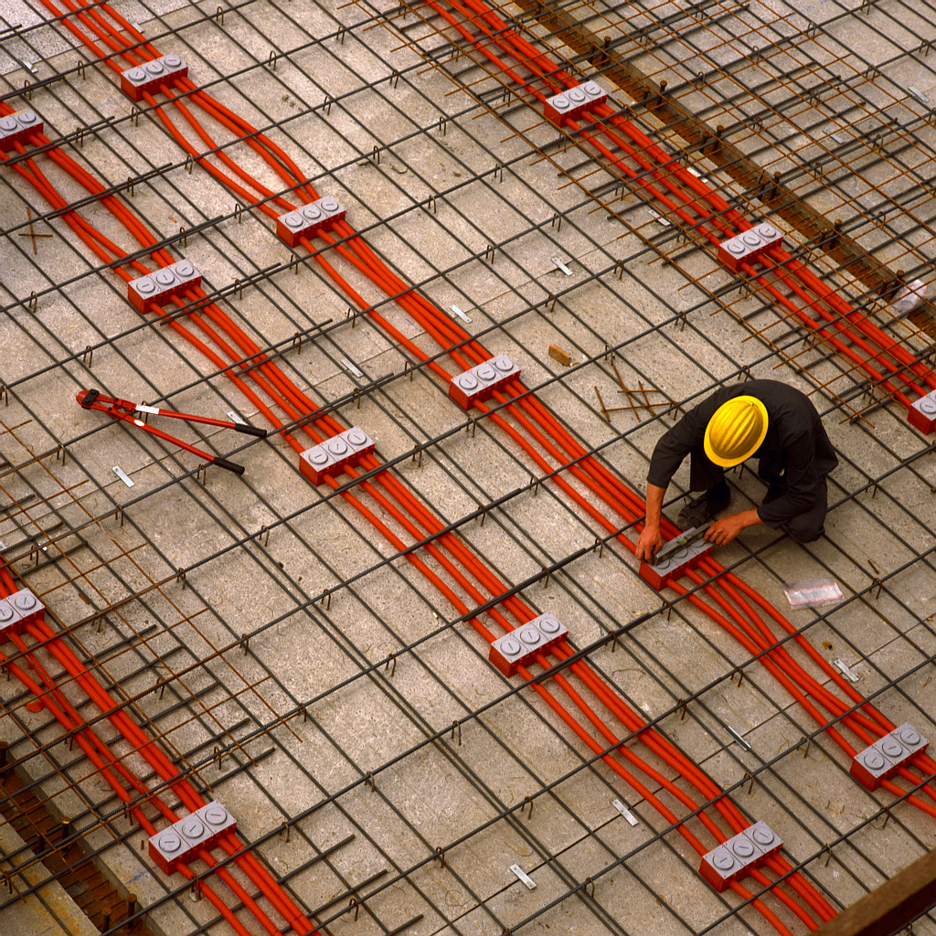
Freemason Compilation Command
There are two things Freemason has to know before it can build a C/C++ project:
What is the platform for which we want to build (PLATFORM variable)
Whether we are interested in a debug build (DEBUG=1) or an optimized one (OPT=1).
In this part of the lesson, we will perform a debug build for a platform called “win32”, that targets x86 machines running Windows, and uses a C++ compiler from Microsoft.
Freemason services are provided through a single command (also called ”driver”): mk.

Slide 14
Getting Help: mk help
mk [make-options] [variables...] goal
variables:
PLATFORM=<platform> build for selected platform
OPT=[0|1] build with optimization
DEBUG=[0|1] build without optimization,
generate symbolic info
DEEP=[0|1] build dependant modules (except
prebuilt ones)
SHOW_CMD=[0|1] show commands before
executing them
SHOW_DEPS=[0|1] show module dependency tree
SHOW_DIFFUSE=[0|1|full] show diffusion of module
products
goals:
<none> build the current module
cc compile source file FILE
FILE=<filename>
cpp preprocess source file FILE, producing .i and .itree files
FILE=<filename>
clean remove generated files
install copy executable files into INSTALL_DIR
INSTALL_DIR=<dirname>
make options:
-B unconditionally make all targets
-C DIRECTORY change to DIRECTORY before doing anything
-d print lots of debugging information
-f FILE read FILE as a makefile
-I ignore errors from commands
-j[N] allow N jobs at once; infinite jobs with no arg
-k keep going when some targets can't be made
-n don't actually run any commands; just print them
-P print makefile source, do nothing
-v print the version number of make and exit
-W FILE consider FILE to be infinitely new
--warn-undefined-variables warn when an undefined variable is referenced

Slide 15
sample1/lib1 Windows Compilation
From the sample1/lib1 directory, we issue the command:
mk PLATFORM=win32 DEBUG=1
Freemason responds with:
1
2
3
4
5
Build of lib1 ...
Compiling lib1.cpp ...
Creating library bin/win32-debug/lib1.lib ...
Done.

Slide 16
sample1/test1 Windows Compilation
From the sample1/test1 directory, we issue the command
mk PLATFORM=win32 DEBUG=1
Freemason responds with:
1
2
3
4
5
Build of test1 ...
Compiling test1.cpp ...
Creating program bin/win32-debug/test1.exe ...
make: *** [bin/win32-debug/test1.exe] Error 96

Slide 17
Compilation Errors
To investigate compilation errors, we inspect the make.log file, in the sample1/test1 directory:
1
2
3
4
5
6
7
8
9
10
-------------------------------------------------------------
Fri Jun 13 06:66:00 JDT 2007
Build of test1 ...
-------------------------------------------------------------
Compiling test1.cpp ...
test1.cpp
test1.obj : error LNK2001: unresolved external symbol
"char * __cdecl foo(void)" (?foo@@YAPADXZ)
bin/win32-debug/test1.exe : fatal error LNK1120: 1 unresolved
externals
Notes:
As it appears, there is an undefined symbol. Obviously, it is the function foo(), defined in
lib1.
Since we didn’t tell test1 anything about the latter, it doesn’t add the library to its link command,
leaving the symbol foo undefined.
We have to tell test1 about lib1:
Establish a definitions file (defs.mk, Figure 2.8) that describes the interface of lib1 towards other modules.
Line 1 defines the module’s name (corresponds to the one in makefile).
Line 2 defines the module location, relative to the root of the project, as defined by the SRC_ROOT in the makefiles.
Freemason defines a variable, VROOT (view root), to point to that location. It implies that all projects in a given context should have the same root.
Line 6 defines the module product type, which corresponds to the PRODUCT in makefile.
Lines 4 and 8 introduce Freemason framework resources related to module definitions.
In the next slide, we will see where do the variables MK and VROOT get their values from?

Slide 18
Sample1 Module Dependencies
sample1
test1
depends on
lib1
test1.cpp
makefile
depends.mk
lib1.cpp
lib.h
makefile
defs.mk

Slide 19
Module Interface and Dependencies Specification
sample1/test1/depends.mk
sample1/lib1/defs.mk
1
2
3
define MODULE_DEPENDS.common
(lib1,$(VROOT)/sample1/lib1)
endef
1
2
3
4
5
6
7
8
MODULE=lib1
MODULE_DIR=$(VROOT)/sample1/lib1
include $(MK)/module/start
MODULE_PRODUCT=lib
include $(MK)/module/end
Notes:
defs.mk aren’t invoked directly as main makefiles, but rather included by the Freemason framework once those variables have been defined.

Slide 20
Recompiling sample1/test1
After establishing the defs.mk and depends.mk files,
we’ll try to recompile test1.
sample1/test1 win32 compilation:
1
2
3
4
Build of test1 ...
Creating program bin/win32-debug/test1.exe ...
Done.

Slide 21
Sample1 Project After Windows Compilation
sample1
test1
lib1
test1.cpp
makefile
bin
depends.mk
make.log
lib1.cpp
lib.h
makefile
bin
defs.mk
make.log
win32-debug
win32-debug
test1.exe
test1.obj
test1.cpp.d
lib1.lib
lib1.obj
lib1.cpp.d

Slide 22
Summary – Compiling for Windows
Modules A term module is central to Freemason. It is the basic build unit.
Dependant modules Modules that are used by other modules called dependent modules. The module dependency relation induces a module dependency graph.
Deep build Since the modules are dependant, it’s logical to expect to build both modules with one command. This can be accomplished by adding DEEP=1 to the command with which we built module test1. In Freemason terms, it’s called Deep Build, in which a module and all its dependant modules are built.
Notes:
1. Modules: We’ve already seen examples for modules (test1 and lib1). For those that seek a formal definition, a module is any location that owns either makefile or defs.mk files, or both.
2. Dependant modules: In our example, lib1 is a dependent module of test1 .
3. Deep build: If we examine the build process we just performed, we notice that we executed two build commands, one for each module. However, since the modules are dependant, it’s logical to expect to build both modules with one command. This can be accomplished by adding DEEP=1 to the command with which we built module test1 . In Freemason terms, it’s called Deep Build, in which a module and all its dependant modules are built.
4. bin directory: In this example, we compiled for win32 platform with debug, so the binary files directory is bin/win32-debug.
5. .d files: Freemason’s automatically detects which header files are included by each C/C++ source file it compiles. It then appends .d to the name of the source file and stores the results in the binary directory.

Slide 23
Summary – Compiling for Windows (cont.)
bin directory
Freemason stores binary files it creates (object files, libraries, executables, etc.) under bin directory, followed by a directory that named after the build variant, that is, platform and debug/optimization selection.
.d files
Freemason’s automatically detects which header files are included by each C/C++ source file it compiles. It then appends .d to the name of the source file and stores the results in the binary directory.
Notes:
1. Modules: We’ve already seen examples for modules (test1 and lib1). For those that seek a formal definition, a module is any location that owns either makefile or defs.mk files, or both.
2. Dependant modules: In our example, lib1 is a dependent module of test1 .
3. Deep build: If we examine the build process we just performed, we notice that we executed two build commands, one for each module. However, since the modules are dependant, it’s logical to expect to build both modules with one command. This can be accomplished by adding DEEP=1 to the command with which we built module test1 . In Freemason terms, it’s called Deep Build, in which a module and all its dependant modules are built.
4. bin directory: In this example, we compiled for win32 platform with debug, so the binary files directory is bin/win32-debug.
5. .d files: Freemason’s automatically detects which header files are included by each C/C++ source file it compiles. It then appends .d to the name of the source file and stores the results in the binary directory.

Slide 24
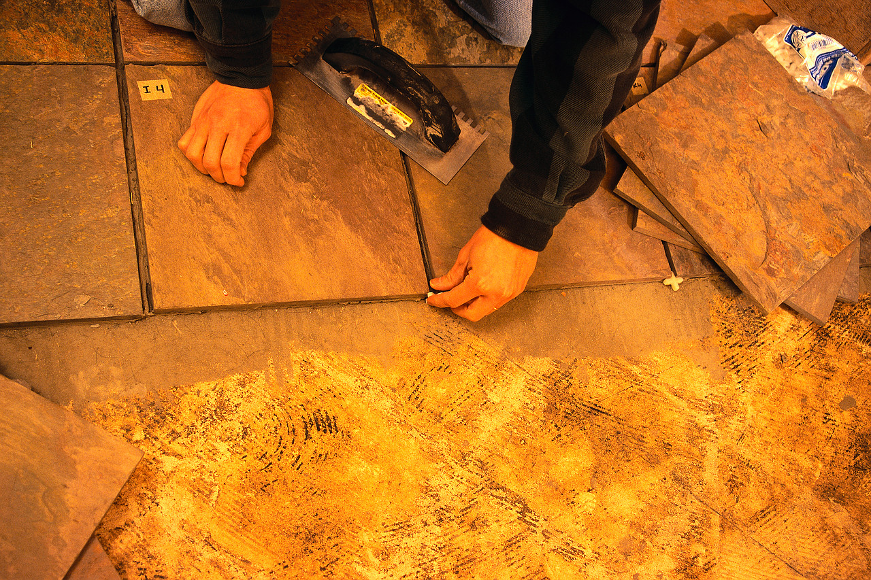
Compiling for VxWorks

Slide 25
Compiling for WxWorks
From the sample1/test1 directory, we issue the command
mk PLATFORM=vxworks OPT=1 DEEP=1
Sample1 compilation for VxWorks:
1
2
3
4
5
6
7
8
9
10
11
Build of lib1 ...
Compiling lib1.cpp ...
Creating library bin/vxworks-opt/lib1.a ...
Done.
Build of test1 ...
Compiling test1.cpp ...
Creating program bin/vxworks-opt/test1.out ...
Done.
Notes:
We requested Freemason to build an optimized version of test1 and lib1 for VxWorks. Actually, this is a bit misleading, since VxWorks compilations are compiler-dependant and architecture-dependant, therefore there cannot be a generic ”vxworks” platform. Thus we assume that our Freemason framework contains a proper definition of such architecture, and that is uses a Diab compiler.

Slide 26
Sample1 project after VxWorks compilation
sample1
test1
lib1
test1.cpp
makefile
depends.mk
bin
lib1.cpp
lib.h
makefile
defs.mk
bin
win32-debug
vxworks-opt
win32-debug
vxworks-opt
test1.out
test1.o
test1.cpp.d
lib1.a
lib1.o
lib1.cpp.d
Notes:
Examining sample1 directories, we reveal a similar outcome to the Win32 compilation, with some variations: The file extentions of the products is different. Instead of ”.exe”, ”.lib”, and ”.obj”, we find ”.out”, ”.a”, and ”.o”. This is due to platform conventions. Freemason is aware of such conventions and names product files accordingly.

Slide 27
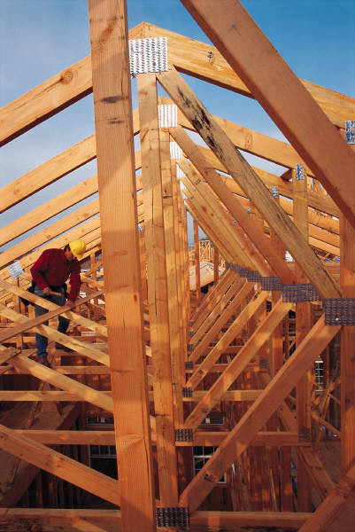
Adding GUI Element

Slide 28
Adding a GUI Element to the Application
test1/test1.cpp
test1/makefile
1
2
3
4
5
6
7
8
9
10
11
12
13
14
15
16
17
#include "lib1/lib1.h"
#if defined(GUI) && defined(_WIN32)
#include <windows.h>
#endif
#include <stdio.h>
int main() {
const char *text = foo();
printf("%s\n", text);
#if defined(GUI) && defined(_WIN32)
MessageBox(0, text, "test1", MB_OK);
#endif
return 0;
}
1
2
3
4
5
6
7
8
9
10
11
12
13
14
15
16
17
18
19
20
21
22
23
24
25
26
27
28
29
30
31
SRC_ROOT=../..
include z:/freemason/4/main
MODULE_NAME=test1
PRODUCT=prog
#-----------------------------
include $(MK)/defs
#-----------------------------
define CC_PP_DEFS.common
endef
define CC_PP_DEFS.windows
GUI
endef
define CC_INCLUDE_DIRS.common
..
endef
define CC_SRC_FILES.common
test1.cpp
endef
#-----------------------------
include $(MK)/rules
Notes:
Suppose we would like to add a GUI element to our application, say a message box.
We will modify test1 in the following manner:
Looking at test1.cpp, one can notice we use two macros to limit the GUI feature to the Win32
platform: _WIN32 and GUI.
The first macro is a predefined in the Microsoft C/C++ compiler, so we don’t need to bother about it.
The second one is our own way to mark the GUI-related code, so we can turn it on or off at will.
We added a CC_PP_DEFS.windows definition to the test1 makefile, containing the GUI macro.
Freemason framework knows to look for platform suffixes of variables like CC_PP_DEFS.

Slide 29
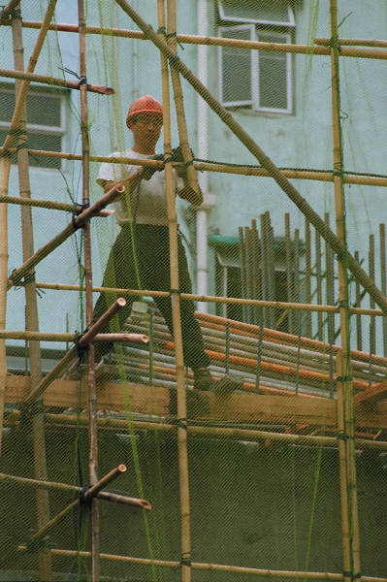
Lib1 Goes Dynamic

Slide 30
Lib1 as a DLL (1)
Preliminary step: cleaning test1
mk PLATFORM=win32 DEBUG=1 clean DEEP=1
Order does not matter!
Notes:
In order for Lib1 to become a DLL, there is a need in an operation that removes the binary files created by some build operation.
Test1, the sole user of lib1 has to be cleaned too, since it is linked with lib1.lib. Although it is enough to merely delete test1.exe, we will perform a full-clean.
And so, from the sample1/test1 directory, we issue the command mk PLATFORM=win32 DEBUG=1 clean DEEP=1
Note that the parameters of mk can come in any order. Freemason is the program where
everything’s made up and the order of the parameters doesn’t matter.
Once we’re done, we can turn into changing lib1 into a DLL.

Slide 31
Lib1 as a DLL (2)
Turning Lib1 into a DLL:
lib1/lib1.cpp
lib1/lib1.h
1
2
3
4
5
6
#include "lib1.h"
LIB1_API const char *foo() {
return "Hello, World!";
}
1
2
3
4
5
6
7
8
9
10
11
#ifdef _WIN32
# ifdef LIB1_EXPORTS
# define LIB1_API __declspec(dllexport)
# else
# define LIB1_API __declspec(dllimport)
# endif
#else
# define LIB1_API
#endif
LIB1_API const char *foo();
Notes:
Thanks to the Microsoft C/C++ cumbersome DLL support, it is much more a C++ programming task than a Freemason one. Inspect the source code changes. Notice than it is for the builder of lib1 to define the macro LIB1_EXPORTS in order for the potion to work.

Slide 32
Lib1 Freemason Files
lib1/makefile
lib1/defs.mk
1
2
3
4
5
6
7
8
9
10
11
12
13
14
15
16
17
18
19
20
21
22
23
24
25
26
27
28
29
30
31
SRC_ROOT=../..
include z:/NBU_BUILD/freemason/4/main
MODULE_NAME=lib1
PRODUCT.windows=so
PRODUCT.vxworks=lib
#------------------------------------
include $(MK)/defs
#------------------------------------
define CC_PP_DEFS.common
endef
define CC_PP_DEFS.windows
LIB1_EXPORTS
endef
define CC_INCLUDE_DIRS.common
endef
define CC_SRC_FILES.common
lib1.cpp
endef
#------------------------------------
include $(MK)/rules
1
2
3
4
5
6
7
8
9
MODULE=lib1
MODULE_DIR=$(VROOT)/lib1
include $(MK)/module/start
MODULE_PRODUCT.windows=so
MODULE_PRODUCT.vxworks=lib
include $(MK)/module/end
Notes:
Lines 6-7 in makefile and 6-7 in defs.mk reflect the duality of lib1’s product type in Win32 and VxWorks platforms.
Note that SO stands for shared object, a synonym of DLL in the UNIX world.
We also added (makefile, lines 18-20) a definition for the macro LIB1_EXPORTS, in CC_PP_DEFS.windows, similarly to what we did for lib1 in the last section.
Note that test1 stays intact - we don’t need to change it at all. It is still linked with lib1.lib, but this time it is lib1’s link library.

Slide 33
Build of Sample1 With Lib1 as a DLL
Performing the build command:
mk PLATFORM=win32 DEBUG=1 DEEP=1
1
2
3
4
5
6
7
8
9
10
11
Build of lib1 ...
Compiling lib1.cpp ...
Creating dynamic library bin/win32-debug/lib1.dll ...
Done.
Build of test1 ...
Compiling test1.cpp ...
Creating program bin/win32-debug/test1.exe ...
Done.

Slide 34
Running Test1 with Lib1 as a DLL
If we try to run test1.exe we get an error, because it cannot
find lib1.dll.
We resolve the problem by asking Freemason to copy files required
by test1.exe to run to a single directory:
mk PLATFORM=win32 DEBUG=1 install INSTALL_DIR=../sandbox
Collecting Sample1 binaries:
1
2
3
Installing bin/win32-debug/test1.exe ...
Installing sample1/lib1/bin/win32-debug/lib1.dll ...
Done.
Notes:
Installing the binary files required by test1.exe to run.
We would like the files to be placed in the directory sample1/sandbox, from which we’ll run test1.exe:
mk PLATFORM=win32 DEBUG=1 install INSTALL DIR=../sandbox

Slide 35
Sample1 Project With Lib1 as DLL
sample1
test1
lib1
sandbox
test1.cpp
makefile
bin
depends.mk
lib1.cpp
lib.h
makefile
bin
defs.mk
test1.exe
lib1.dll
win32-debug
win32-debug
test1.exe
test1.obj
lib1.dll
lib1.lib
lib.obj

Slide 36
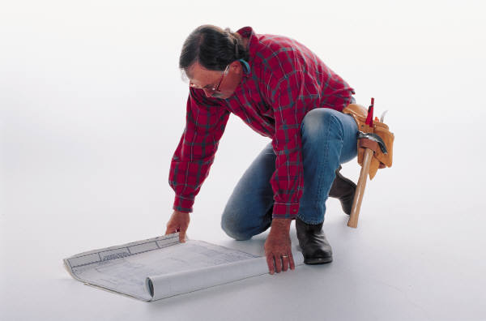
Adding A New Module

Slide 37
String Module (1)
strings/strings.cpp
strings/strings.h
1
2
3
4
5
6
7
8
9
10
11
12
13
14
15
16
17
18
19
#include "strings.h"
#include <stdlib.h>
String::String(const char *str) {
s = str ? strdup(str) : 0;
}
String::~String() {
if (s)
free(s);
}
const char *String::c_str() {
return s ? s : "";
}
1
2
3
4
5
6
7
8
9
10
11
12
#include <string.h>
class String {
char *s;
public:
String(const char *str = 0);
~String();
const char *c_str();
};
Notes:
After being promoted, lib1 just had to find itself subordinates. The result of this effort is a new strings module. It is a minimal string class, with makefiles that are more or less identical to the ones of the first lib1 module.
On lib1’s side, we added a depends.mk file in order to list strings as a dependant module, and modified lib1.cpp to use the String class.

Slide 38
String Module (2)
strings/makefile
strings/defs.mk
1
2
3
4
5
6
7
8
9
10
11
12
13
14
15
16
17
18
19
20
21
22
23
24
25
26
SRC_ROOT=../..
include z:/NBU_BUILD/freemason/4/main
MODULE_NAME=strings
PRODUCT=lib
#------------------------------------
include $(MK)/defs
#------------------------------------
define CC_PP_DEFS.common
endef
define CC_INCLUDE_DIRS.common
endef
define CC_SRC_FILES.common
strings.cpp
endef
#------------------------------------
include $(MK)/rules
1
2
3
4
5
6
7
8
MODULE=strings
MODULE_DIR=$(VROOT)/strings
include $(MK)/module/start
MODULE_PRODUCT=lib
include $(MK)/module/end

Slide 39
lib1 With Strings
lib1/lib1.cpp
lib1/depends.mk
1
2
3
4
5
6
7
8
#include "lib1.h"
#include "strings/strings.h"
LIB1_API String foo() {
Strins hello = "Hello, World!";
return hello.c_str();
}
1
2
3
define MODULE_DEPENDS.common
(strings,$(VROOT)/sample1/strings)
endef

Slide 40
Link Diagrams
VxWorks Link
Windows Link
test1.out
test1.exe
lib1.a
strings.a
lib1.lib
lib1.dll
strings.lib
link library
Notes:
According to the graph above:
In VxWorks: lib1 and strings are libraries (archives), and both are linked into test1.out.
In Win32: lib1 is a DLL (actually, an executable). Its link library is linked with test1.exe, while strings.lib is linked with lib1.dll. Note that test1.exe never meets strings.lib.

Slide 41
test1 Module Diffusion
VxWorks Diffusion
Windows Diffusion
test1
test1
diffused
lib1
lib1
strings
strings
blocked
Notes:
Freemason uses a semantics of module product diffusion in order to handle the links in the most compact way.
Examine the diffusion graphs above. Notice that at the base of the diffusion graph lies a common module dependency graph, that reflects the relation between symbol definition and usage in terms of modules (that is, if module M1 defined a symbol that is used by module M2, we say that M2 depends on M1).

Slide 42
test1 Dependencies and Diffusion Report
Printing a dependency graph is done with the command:
mk PLATFORM=win32 DEBUG=1 show-deps
(PLATFORM=vxworks yields the same result)
Dependencies
1 test1 []
2 ... lib1 [test1]
3 ... ... strings [lib1]
Windows Diffusion
VxWorks Diffusion
1 test1 []
2 ... lib1 [test1]
3 ... ... strings [lib1]
4 >> LIB: strings.lib
5 > LIB: strings.lib
6 >> SO: lib1.lib
7 >> SO: lib1.lib
1 test1 []
2 ... lib1 [test1]
3 ... ... strings [lib1]
4 >> LIB: strings.a
5 > LIB: strings.a
6 >> LIB: lib1.a strings.a
7 >> LIB: lib1.a strings.a
Notes:
In the module dependency graph, some modules let products of dependant modules ”diffuse”
through, while other do not. The quality of diffusion is determined solely by module type.
For instance, on VxWorks, a library (lib1) will let another library (strings) diffuse into a program (test1 ), where it would be linked. On the other hand, on Win32, a DLL (lib1) will not allow a library (strings) to diffuse through, and link it by itself.
Note: We can request Freemason to print dependency graphs and diffusion graphs. Due to the potential complexity of such graphs, Freemason prints them as trees (by repeating nodes where needed):
1. Module that appears in square brackets is the parent module of the one listed to their left.
2. Lines that begin with > list modules that are trying to diffuse through the module on the same level of indentation. For instance, line 5 tells us that the library strings.lib is trying to diffuse through module lib1.
3. Lines that begin with >> list modules that have successfully diffused through the module on the same level of indentation. For instance, line 6 tells us that is Win32, the link library lib1.lib has diffused through module lib1, whereas in VxWorks, both lib1.a and strings.a have managed to do the same.
4. The last line in the diffusion reports tells us what products will take part of the build process of the root module (in this case, ”test1”).

Slide 43
Freemason Architecture

Slide 44
The Freemason – How does It Work?
Source Code
Module B
Source File
Source File
Module A
Source File
Source File
Source File
Source File
Module C
Source File
Source File
Source File
Notes:
The Freemason world is composed of source code organized into modules.
Each module contains source files to be built into a product.
A Product is mostly a binary file such as a library or an executable.

Slide 45
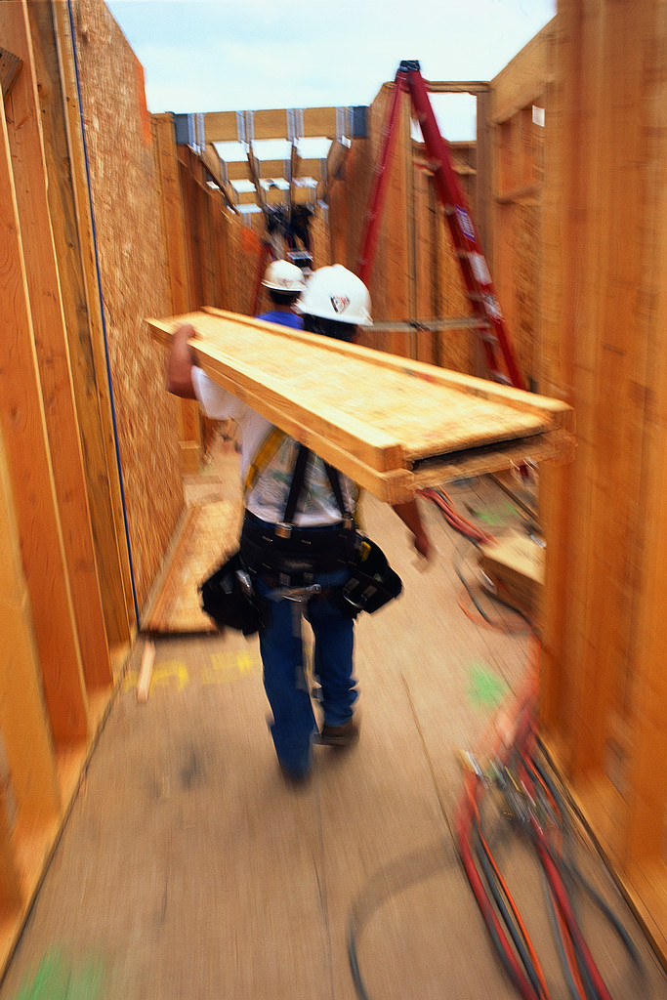
The Freemason – Targets
Products may be built for numerous targets using a selection of tools (i.e., compilers).
In order for Freemason to get a clear notion of what is expected from it, there is a needs to only specify the target platform.
Notes:
Targets = a general name for operating systems and hardware architectures - CPU, board, etc.
In order to reduce complexity of target specification, the Freemason uses an arbitrary concept of platform to denote a particular selection of target OS, target architecture, and build tools.

Slide 46
The Freemason – Module Dependencies
Apart from its source files, a module may require the products of other modules in order to build its own.
If products of dependant modules are not available in advance, they should be built before they are required by their dependees.
Freemason allows modules to specify their dependencies and efficiently takes care of the recursive build operation in a process called deep build.
Notes:
The Freemason denotes such modules “dependant modules” or just “module dependencies”.
The modules dependencies in the Freemason are not to be confused with dependencies of C/C++ source files, to which we refer as source file dependencies.
This operation has a recursive manner, since dependant modules may have dependencies of their own.

Slide 47
Module Dependencies
Module A
{
f ( ) ;
}
depends on
Module B
f ( )
{
}

Slide 48
Freemason Architecture

Slide 49
Freemason Architecture - Framework
Freemason is essentially a combination of makefiles, organized in a hierarchical structure called Framework.
The framework files that are used during a Freemason session depending on the session configuration (that is, values of configuration variables, such as PLATFORM or DEBUG).
Notes:
The framework is of a dynamic nature, and may change from time to time. In the most common scenario, the framework is a treated part of the source code it used to compile, and therefore holds the same version control markers (i.e. labels) as the source code.

Slide 50
View
Freemason assumes that the file system containing source files in a given build session share a common root directory.
The directory structure is called view.
The common root directory is called view root.
The only exceptions to this rule are SDK files and the Freemason Framework files.
It is highly recommended to keep the Freemason Framework inside the view, especially when a source control system is involved.

Slide 51
Repository
In order for Freemason to be able to perform actual compilations, it needs to be able to access build tools (i.e. compilers) and SDK resources (header files and libraries).
Such resource are stored in a location that’s called Repository, typically in a shared network location.
Since such resources are not always subject to version control, it should contain explicit version specification as part of the directory structure, and avoid modification of the standard, ”off-the-self” packages of the development tools.
Freemason uses the NBU_BUILD_ROOT environment variable to locate its repository.
Notes:
Although it is possible to configure Freemason to use such resources from the host that runs the compilation, it is sometimes easier to rely on a common, stable resources. Such resource are stored in a location that’s called Repository, typically in a shared network location.

Slide 52
GNU Make
The engine that drives Freemason is GNU make with syntax extension.
The definition files of Freemason are actually makefiles.
The basic GNU make syntax is valid in Freemason files, including variable definitions, conditional control structures and ’include’ directives.

Slide 53
Modules
Freemason module is either a white-box, a black-box, or both.
A black-box module:
Able to build itself from its source files.
Can be referenced and used by other modules (i.e., a module that represents a library that can be linked to an application).
Owns a defs.mk file.
A White-box module:
Owns a makefile file.
Both kind of modules may have dependant modules.

Slide 54
Module Dependencies
Both White box and black box modules may have dependant modules.
Module dependencies are described in a depends.mk files which are the basic Freemason module description files.
Modules may also have any number of arbitrary makefiles, that may be references (mostly, included) from the basic Freemason module description files.
In a typical (and also, recommended) configuration, Freemason module description files reside next to the module’s source files. However, there’s no rule against putting them anywhere in the system, as long as they are kept together.
In this case, we should tell Freemason how to find the module’s source files.

Slide 55
Environment Variables
In order to avoid mis-configuration of the build process, Freemason intentionally tries to avoid using of environment variables.
All configuration aspects should be handled from within the Freemason module configuration files or from the Framework.

Slide 56
Freemason Procedures

Slide 57
Installation
Define the NBU_BUILD_ROOT environment variable to r:/build (we assume r: is mapped to \\storage\\NBU\\Build).
Append the directory %NBU_BUILD_ROOT%\sys\scripts\bin to the back of your PATH.
Notes:
Freemason does not require installation of any development tool, IDE or SDK.
It is planned to coexist with development tools installed locally on a builder host.

Slide 58
Interaction
Freemason services are provided through a single command (also called ”driver”):mk.
All operations concerning a module are performed from the directory containing its definition files.
The driver resides at the Freemason Repository, and serves as a dispatcher to the GNU make utility in the active view.

Slide 59
Interaction – Basic Examples (1)
Build a module for Windows platform with debug info:
mk PLATFORM=rv-win32 DEBUG=1
Build an optimized module for the RV755 platform:
mk PLATFORM=rv-755 OPT=1
Build an optimized module for TAMAR platform:
mk PLATFORM=rv-tamar OPT=1

Slide 60
Interaction – Basic Examples (2)
Build a module along with all its dependencies:
mk PLATFORM=... DEEP=1
Clean all build products for a given module:
mk PLATFORM=... clean

Slide 61
Modules
A module owns three definition files, describing its properties:
makefile
defs.mk
depends.mk
TBD deep build
TBD prebuilt products

Slide 62
Product Configuration
Supported products include:
prog Windows executable or VxWorks .out/.fls file
lib Library (archive)
so Shared Object (DLL) (Windows only)
pl Partially-linked Object (VxWorks only)
winapp Windows Application
mfcapp Windows MFC Application
none No product
Notes:
None = no product: used in products that do nothing but probably get paid quite a lot.

Slide 63
Target Operating System Configuration
Supported target operating systems include:
win32 Windows
vxworks-5.5 VxWorks 5.5
vxworks-6.3 VxWorks 6.3

Slide 64
Target Platform Configuration
Currently defined target platforms:
rv-win32 Windows platform
Target OS Windows
Target Architecture x86
CC tool Microsoft C/C++ Compiler version 12.0
rv-755 RV755 platform
Target OS VxWorks 5.5
Target Architecture RV755 board
CC tool Diab 5.0
rv-tamar TAMAR platform
Target OS VxWorks 6.3
Target Architecture TAMAR board
CC tool Diab 5.4

Slide 65
Builder Host
Freemason does not require installation of any development tool, IDE or SDK.
However, if one wishes that Freemason will use such a component, it is easy to establish such configuration without modifying the framework.

Slide 66
The Repository
Note: when traveling.

Slide 67
Modules Revisited

Slide 68
C/C++ Preprocessing Facilities

Slide 69
Freemason Chapter Heading - TBD

Slide 70
Make Targets
cc
cpp
clean
install
show-deps

Slide 71
Variables
DEEP
SHOW_CMD
SHOW_DEPS
SHOW_DIFFUSE
FILE

Slide 72
Useful MAKE options
-n
-jN
-k
-B
-P
-v

Slide 73
Target Architectures
Currently, the concept of target architecture corresponds to the target system’s CPU.
Supported target architectures include:
x86 Standard Intel-based PC
ppc-604 RV755 board
ppc-85xx TAMAR board

Slide 74
Build Tools
Supported build tools include:
msc-12 Microsoft C/C++ Compiler version 12.0 (i.e. Visual Studio 6)
diab-5.0 Diab 5.0 (i.e. VxWorks 5.5, Tornado 2.2)
diab-5.4 Diab 5.4 (i.e. VxWorks 6.3, Workbench 2.5)
diab-5.5 Diab 5.5 (i.e. VxWorks 6.3, Workbench 2.6)
asn.1 ASN.1 compiler
Notes:
Additional tools we plan to support:
• GCC C/C++ Compiler
• Flex and Bison

Slide 75
More Development Tools
The tools that are not categorized as primary build tools, but may take part in the build process or provide useful information during development.
They are accessible through specification of a MAKE target or a MAKE variable.

Slide 76
Supported Tools
GNU CPP (C preprocessor)

Slide 77
Future Tool Support
Additional tools we plan to support:
PC-Lint
BoundsChecker, Insure++ (memory debugging tools for Windows)
BullseyeCoverage (coverage analysis tool)
ElectricFence, Valgrind (memory debugging tools for Linux)

Slide 78
Freemason Troubleshooting

